Slide 1
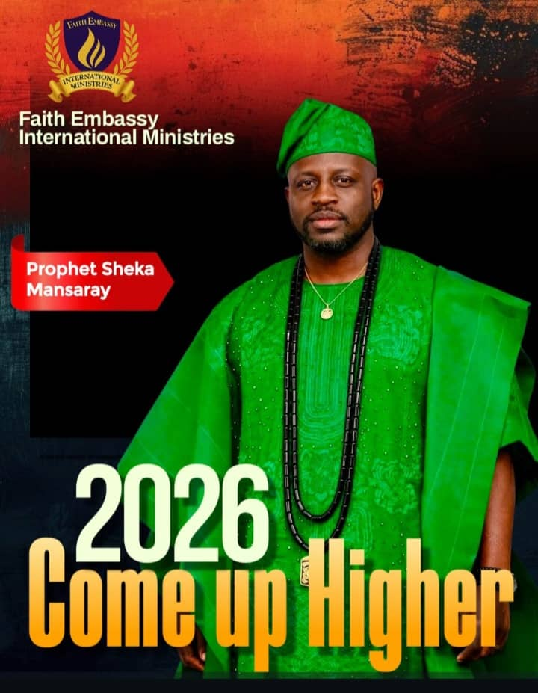

Slide 2
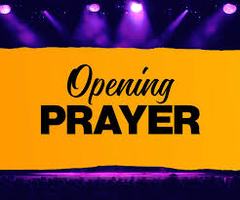

Slide 3


Slide 4


Slide 5
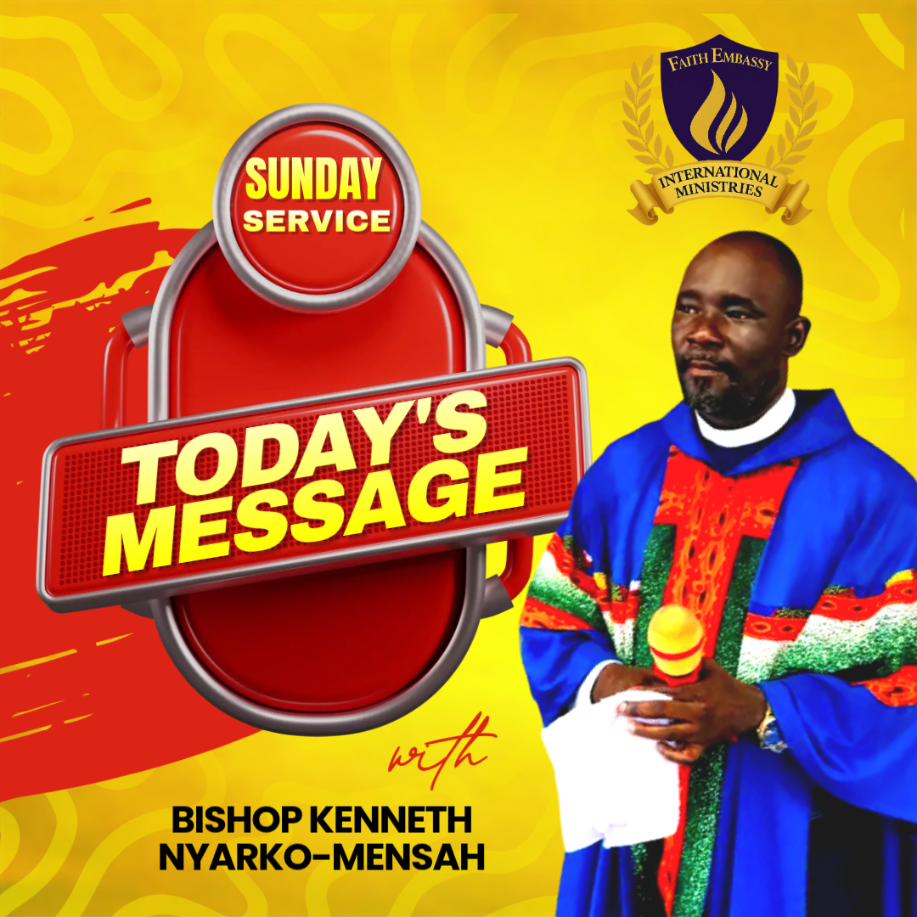

Slide 6

TOPIC:
FROM PROPHECY TO POSSESSION

Slide 7
The prophetic is bringing expressions of the Spirit of wisdom in everyday life, in our homes, families, workplaces, communities, nations, in all spheres so that the glory of God is revealed and His Kingdom is advanced here on earth.

Slide 8
ANCHOR SCRIPTURE: JOSHUA 21:45
"There failed not ought of any good thing which the LORD had spoken unto the house of Israel; all came to pass". KJV:

Slide 9
SUPPORTING SCRIPTURES:
NUMBERS 23:19
“God is not a man, that He should lie, Nor a son of man, that He should repent. Has He said, and will He not do? Or has He spoken, and will He not make it good?

Slide 10
ISAIAH 60:22
A little one shall become a thousand, And a small one a strong nation. I, the Lord, will hasten it in its time.”

Slide 11
KEY THEMES IN JOSHUA 21:45:
FULFILLMENT OF PROMISES:
God kept His word, fulfilling promises made to Abraham and his descendants over generations.
GOD'S FAITHFULNESS:
God's trustworthy character and His ability to deliver on His promises, even when His people struggled.

Slide 12
PROVISION & VICTORY:
It concludes the account of Israel taking possession of the land, showing God's provision, granting them rest, and handing their enemies over to them.

Slide 13
TEACHING / INSIGHT
Prophecy is not fulfilled by excitement but by endurance.
Many start with revelation but stop at responsibility.
Possession requires patience, obedience, and consistency.

Slide 14
God is faithful, but fulfillment follows order.
Prophecy gives you the promise, but obedience gives you the possession.
Israel heard the promise in Exodus but possessed it in Joshua.

Slide 15
In evil times, many quit too early.
Abraham waited, Joseph endured, and David matured.
God does not rush destinies; He prepares vessels.

Slide 16
Exodus 35:10,20,21,26
10 'All who are gifted artisans among you shall come and make all that the LORD has commanded:
20 And all the congregation of the children of Israel departed from the presence of Moses.

Slide 17
REVELATION KEYS (WITH SCRIPTURES)
Prophecy finds fulfillment through obedience
Deuteronomy 28:1
“Now it shall come to pass, if you diligently obey the voice of the Lord your God, to observe carefully all His commandments which I command you today, that the Lord your God will set you high above all nations of the earth.

Slide 18
2. TIME TESTS EVERY PROPHETIC WORD
PSALM 105:19
Until the time that his word came to pass, The word of the Lord tested him.

Slide 19
3. ENDURANCE IS PROOF OF BELIEF
HEBREWS 10:36
For you have need of endurance, so that after you have done the will of God, you may receive the promise:

Slide 20
INSTRUCTION IS THE BRIDGE
TO MANIFESTATION
JOHN 2:5
His mother said to the servants, “Whatever He says to you, do it.”

Slide 21
5. DELAY REFINES CHARACTER
ROMANS 5:3–4
And not only that, but we also glory in tribulations, knowing that tribulation produces perseverance;
⁴ and perseverance, character; and character, hope.

Slide 22
6. Faith must be matched with works
JAMES 2:17
Thus also faith by itself, if it does not have works, is dead.

Slide 23
PROPHETIC REFLECTIONS /
CHALLENGES
You don’t just carry prophecy, you must become it.
Stay long enough to see it fulfilled.

Slide 24
PRAYER POINTS
Father, give me grace to endure until fulfillment.
I receive strength to obey divine instructions.
I reject premature quitting and spiritual impatience.
Let my life become a testimony of fulfilled prophecy.
I step fully into what God has promised me.

Slide 25


Slide 26


Slide 27


Slide 28
